Slide 1

Environmental justice
COMP 4882 CAPSTONE
A.M., B.E., J.X.
Feb 6, 2024

Slide 2

Goals for the project
A dashboard which is easy to export a excel/table/text report with the past information of pollution event happening in Tennessee, which applies terms selections (water, air, waste, noise), period time selections (year, month, day), location selection (county, city name of TN) and the recourse information (title, reporter, recourse link address)
A Word Cloud tool base on the date selection with terms, period time, location and recourse selection to show the results perceptually.
A Map of Tennessee Pollution events of reliable data collection with terms, period time, location and recourse selection.

Slide 3
Goals for Sprint 1:
1. Collect a list of online news platform (will verify with the client) from two part:
a) social news platform, such as Fox news, CNN, Localmemphis
b) professional environment reporter news platform
2. Collect a list of seed/key word of pollution event, including the professional vocabulary for the pollution terms, such as PM2.5 for the air pollution, so on.
3. Design vision looking for the final report form of the Dashboard, word cloud, and map.

Slide 4

Main method in project
Technical skills (news/data collection)
web crawler in py
web scraper in py
Data Analysis
Key word database set up
data adjustment for accuracy and precise tracking
organize all the info with location and date
Data visualization
Word cloud and data relative
Map/location and data relative
Visualization Design
Dashboard/interface vision
Ux design

Slide 5

Key/seed words

Slide 6
Pollution events key/seed words
Term: | Part of key words
General | Public Health, pollution, Pollution event, Environmental incident, Contamination event, Pollution occurrence, Environmental contamination, Environmental disaster, Pollution outbreak, Environmental emergency, Pollution crisis, Environmental hazard, Pollution accident, Pollution occurrence, Environmental mishap, Pollution episode, Environmental contamination incident, Pollution, occurrence, Environmental pollution event, Pollution event report, Environmental contamination outbreak, Pollution event investigation...
air | breath, gas, smoke, Air pollution, Air quality, Particulate matter,PM2.5,PM10,Ozone,Nitrogen dioxide (NO2),Sulfur dioxide (SO2),Carbon monoxide (CO),Volatile organic compounds (VOCs),Airborne pollutants, Indoor air pollution, Outdoor air pollution, Emissions, Combustion,Traffic pollution,Industrial emissions,Urban air quality, Rural air quality,Air quality index (AQI),Health effects of air pollution,Respiratory diseases,Cardiovascular diseases,Asthma,Lung cancer,Air pollution monitoring,Air pollution control measures,Air pollution regulations,Clean air initiatives,Air quality management,Air pollution sources,Atmospheric pollutants,Greenhouse gases,Smog,Haze,Aerosols,Air pollution exposure,Air pollution effects on ecosystems,Air pollution modeling,Air quality standards…
water | Water pollution,Water quality,Contaminants,Wastewater,Surface water pollution,Groundwater contamination,Industrial discharge,Agricultural runoff,Urban runoff,Sewage pollution,Nutrient pollution,Eutrophication,Chemical pollutants,Heavy metals,Pesticides,Herbicides,Fertilizers,Pharmaceuticals,Microplastics,Oil spills,Sedimentation,Pathogens,Bacteria,Viruses,Protozoa,Waterborne diseases,Drinking water contamination,Recreational water contamination,Harmful algal blooms,Cyanobacteria,Marine pollution,Freshwater pollution,Aquatic ecosystems,Water treatment,Water filtration,Water purification,Water quality standards,Water monitoring,Water conservation,Clean water initiatives.
waste | Waste pollution,Waste management,Solid waste,Municipal waste,Industrial waste,Hazardous waste,Toxic waste,Electronic waste (E-waste),Plastic waste,Waste disposal,Landfill,Incineration,Recycling,Waste reduction,Waste segregation,Composting,Waste treatment,Waste-to-energy,Pollution prevention,Pollution control,Waste generation,Waste sorting,Waste collection,Waste transportation,Waste processing,Waste recycling,Waste incineration,Waste landfilling,Waste regulations,Environmental impact of waste,Waste contamination,Leachate,Methane emissions,Greenhouse gas emissions from waste,Waste management practicesWaste management technologies,Waste audit,Waste stream analysis,Sustainable waste management,Circular economy.
noise | Noise pollution,Environmental noise,Sound pollution,Noise levels,Decibels (dB),Traffic noise,Road noise,Highway noise,Aircraft noise,Airport noise,Railway noise,Train noise,Construction noise,Industrial noise,Workplace noise,Community noise,Urban noise,Rural noise,Noise exposure,Noise measurement,Noise monitoring,Noise control,Noise regulations,Noise mitigation,Noise barriers,Noise insulation,Noise reduction,Noise standards,Health effects of noise pollution,Noise-induced hearing loss,Sleep disturbance,Annoyance due to noise,Psychological effects of noise,Noise and cardiovascular health,Noise and mental health,Noise mapping,Noise modeling,Noise hotspots,Quiet zones,Noise abatement measures.

Slide 7
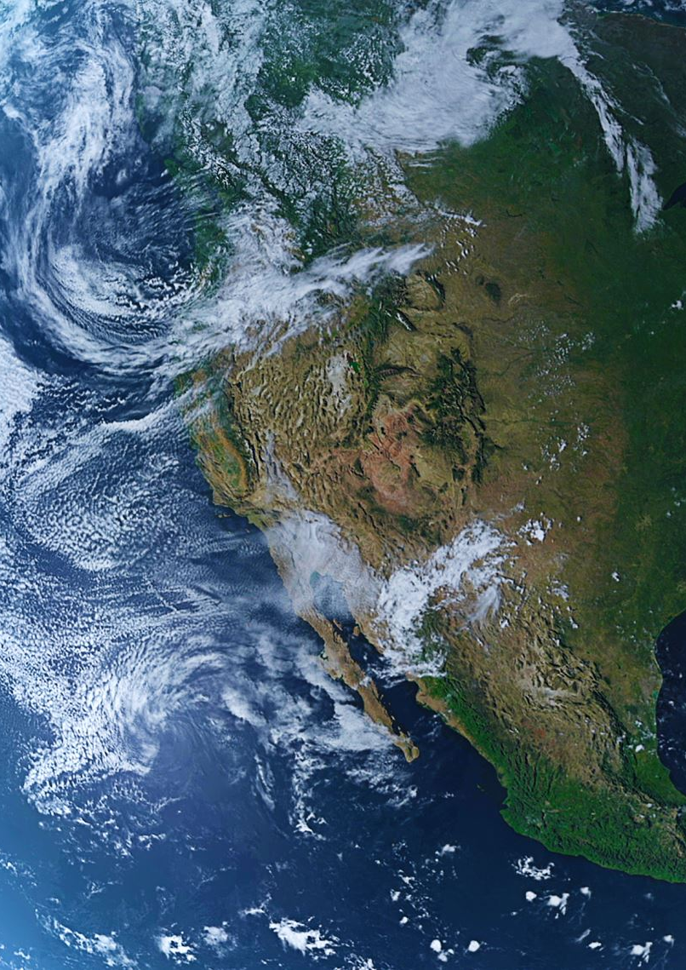
environmental pollution report/news:
Environmental Protection Agency (EPA) - EPA
World Health Organization (WHO) - WHO
National Geographic - National Geographic Environment
The Guardian Environment - The Guardian Environment
Environmental News Network (ENN) - ENN
Environmental Health News (EHN) - EHN
Inside Climate News - Inside Climate News
ScienceDaily - ScienceDaily Environment
Greenpeace - Greenpeace
The Conversation Environment - The Conversation Environment

Slide 8

official website for the state of Tennessee:
The Tennessean: The Tennessean
WATE: WATE
WSMV News4 Nashville: WSMV News4 Nashville
WKRN News 2: WKRN News 2
Chattanooga Times Free Press: Chattanooga Times Free Press
Knoxville News Sentinel: Knoxville News Sentinel

Slide 9

Major US News Websites:
CNN: CNN
The New York Times: The New York Times
The Washington Post: The Washington Post
NBC News: NBC News
CBS News: CBS News
ABC News: ABC News
USA Today: USA Today
Fox News: Fox News
Reuters: Reuters
Associated Press (AP) News: AP News

Slide 10

All Counties in Tennessee:
Anderson, Bedford, Benton, Bledsoe, Blount, Bradley, Campbell, Cannon, Carroll, Carter, Cheatham, Chester, Claiborne, Clay, Cocke, Coffee, Crockett, Cumberland, Davidson, Decatur, DeKalb, Dickson, Dyer, Fayette, Fentress, Franklin, Gibson, Giles, Grainger, Greene, Grundy, Hamblen, Hamilton, Hancock, Hardeman, Hardin, Hawkins, Haywood, Henderson, Henry, Hickman, Houston, Humphreys, Jackson, Jefferson, Johnson, Knox, Lake, Lauderdale, Lawrence, Lewis, Lincoln, Loudon, Macon, Madison, Marion, Marshall, Maury, McMinn, McNairy, Meigs, Monroe, Montgomery, Moore, Morgan, Obion, Overton, Perry, Pickett, Polk, Putnam, Rhea, Roane, Robertson, Rutherford, Scott, Sequatchie, Sevier, Shelby, Smith, Stewart, Sullivan, Sumner, Tipton, Trousdale, Unicoi, Union, Van Buren, Warren, Washington, Wayne, Weakley, White, Williamson, Wilson.

Slide 11

major 100 cities in Tennessee:
Memphis, Nashville, Knoxville, Chattanooga, Clarksville, Murfreesboro, Franklin, Jackson, Johnson City, Bartlett, Hendersonville, Kingsport, Collierville, Smyrna, Cleveland, Brentwood, Germantown, Columbia, Spring Hill, La Vergne, Gallatin, Cookeville, Lebanon, Morristown, Oak Ridge, Maryville, Bristol, Farragut, Shelbyville, East Ridge, Tullahoma, Dyersburg, Springfield, Goodlettsville, Greeneville, Sevierville, Dickson, Elizabethton, McMinnville, Athens, Soddy-Daisy, Portland, Lakeland, Lewisburg, Red Bank, Arlington, Crossville, Martin, Lawrenceburg, Millington, Union City, Alcoa, Paris, Clinton, Humboldt, La Follette, Lexington, Manchester, Hartsville/Trousdale County, Brownsville, Ripley, Covington, Atoka, Signal Mountain, Winchester, Lenoir City, McKenzie, Newport, Jefferson City, Loudon, Jonesborough, Lafayette, Fairview, Harrogate, Middle Valley, Milan, Dayton, Pulaski, White House, Harriman, Munford, Dunlap, Oakland, Savannah, Millersville, Henderson, Collegedale, Pigeon Forge, Erwin, Smithville, Sweetwater, Forest Hills, Kingston, Mount Carmel, Sparta, Rockwood, Church Hill, Nolensville, La Grange, Tusculum…
All Cities’ names in TN found here: https://www.mtas.tennessee.edu/cities_alpha?q=cities_alpha&page=17

Slide 12
Dashboard demo

Slide 13
Dashboard function

